Slide 1
Introduction to Differential Equations
Dr. Anirban Tarafdar
Assistant Professor, Amrita Vishwa Vidyapeetham,

Slide 2
Where do ODE’s arise
All branches of Engineering
Economics
Biology and Medicine
Chemistry, Physics etc
Anytime you wish to find out how something changes with time (and sometimes space)

Slide 3

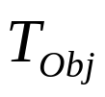

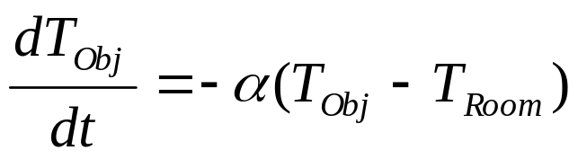
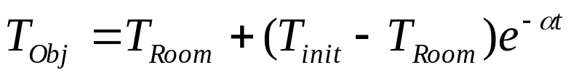

Example – Newton’s Law of Cooling
This is a model of how the temperature of an object changes as it loses heat to the surrounding atmosphere:
Temperature of the object:
Room Temperature:
Newton’s laws states: “The rate of change in the temperature of an object is proportional to the difference in temperature between the object and the room temperature”
Form ODE
Solve
ODE
Where is the initial temperature of the object.

Slide 4
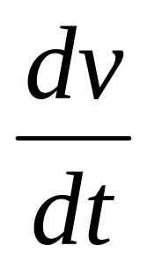
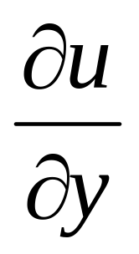
Derivatives
Derivatives
Ordinary Derivatives
v is a function of one
independent variable
Partial Derivatives
u is a function of
more than one
independent variable

Slide 5
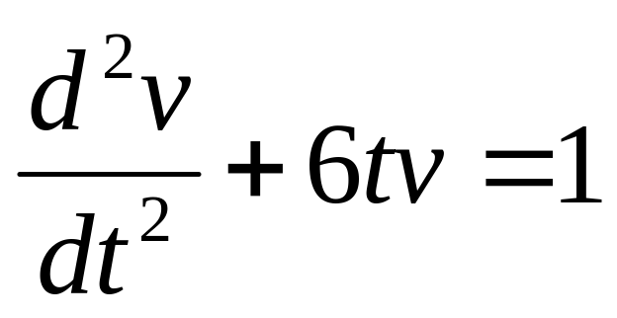
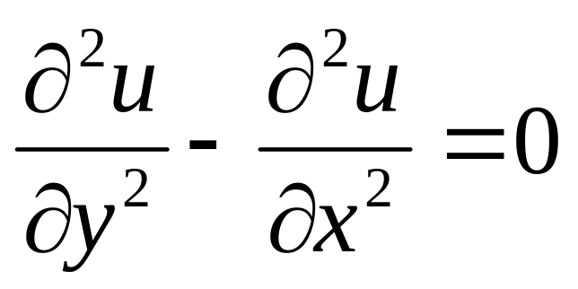
Differential Equations
Differential
Equations
Ordinary Differential Equations
involve one or more
Ordinary derivatives of
unknown functions
Partial Differential Equations
involve one or more
partial derivatives of
unknown functions

Slide 6
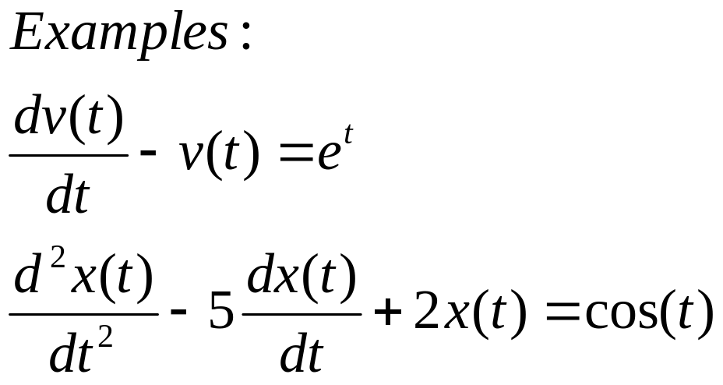
Ordinary Differential Equations
Ordinary Differential Equations (ODEs) involve one or more ordinary derivatives of unknown functions with respect to one independent variable
x(t): unknown function
t: independent variable

Slide 7
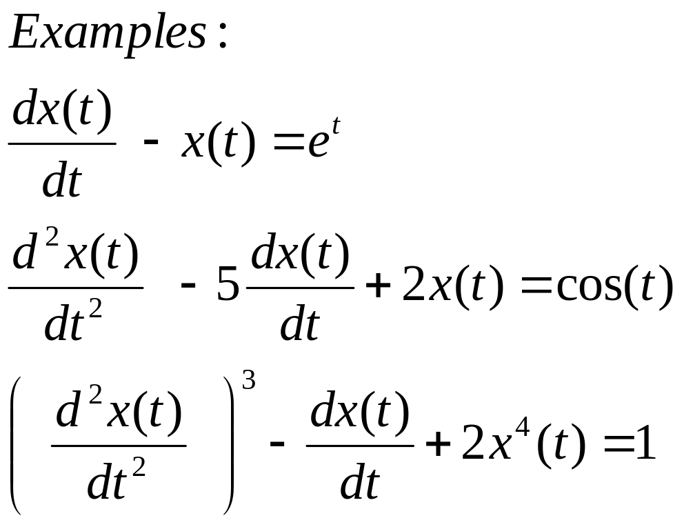
Order of a Differential Equation
The order of an ordinary differential equation is the order of the highest order derivative.
First order ODE
Second order ODE
Second order ODE

Slide 8
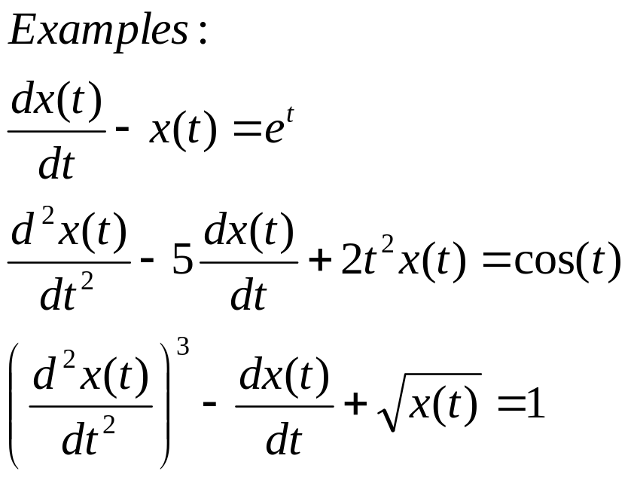
Linear ODE
An ODE is linear if
The unknown function and its derivatives appear to power one
No product of the unknown function and/or its derivatives
Linear ODE
Linear ODE
Non-linear ODE

Slide 9
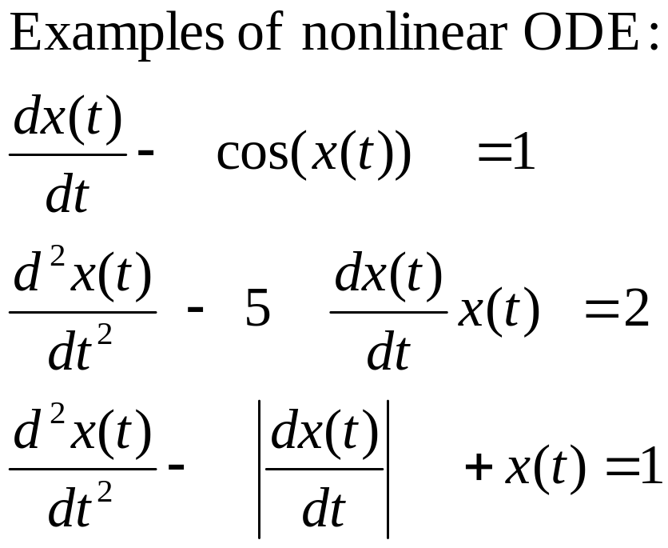
Nonlinear ODE
An ODE is linear if
The unknown function and its derivatives appear to power one
No product of the unknown function and/or its derivatives

Slide 10
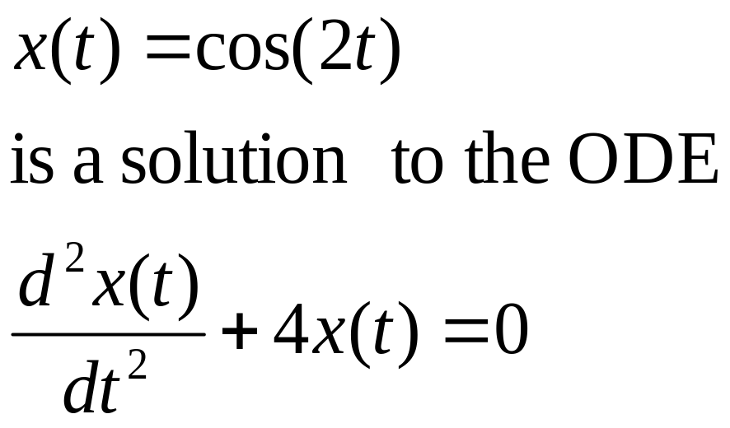
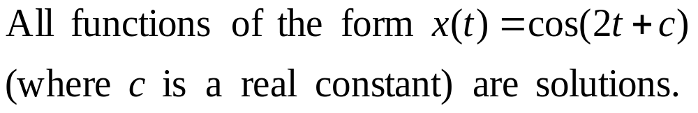
Solutions of Ordinary Differential Equations
Is it unique?

Slide 11
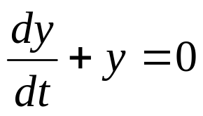
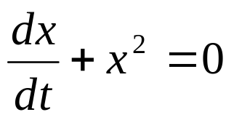
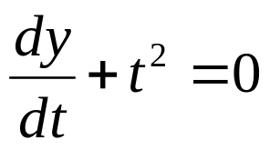
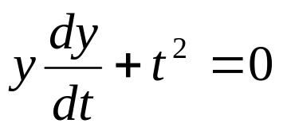
Linearity - Examples
is linear
is non-linear
is linear
is non-linear

Slide 12




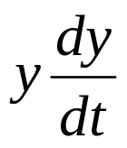


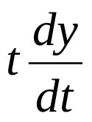
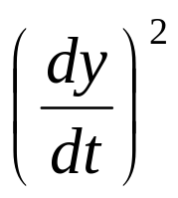
Linearity – Summary
Linear | Non-linear
or

Slide 13



Linearity – Special Property
If a linear homogeneous ODE has solutions:
and
then:
where a and b are constants,
is also a solution.

Slide 14
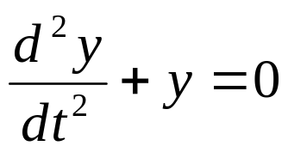


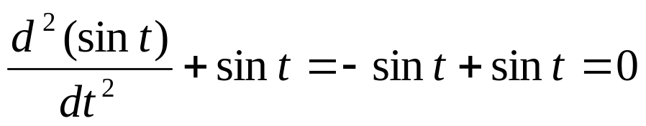
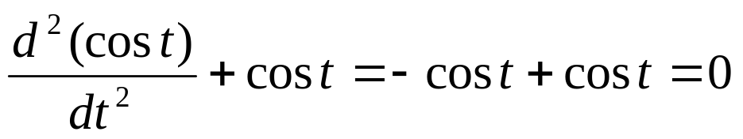

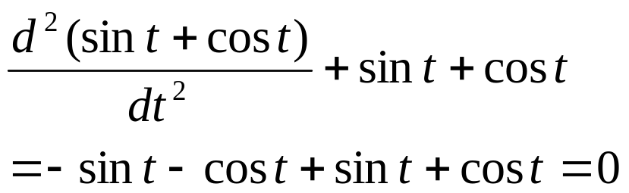
Linearity – Special Property
Example:
has solutions
and
Check
Therefore
is also a solution:
Check

Slide 15
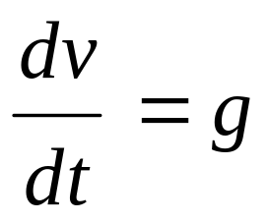
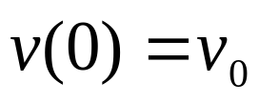
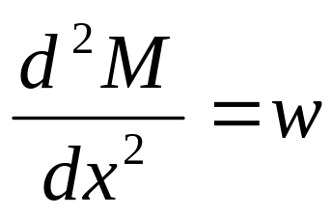
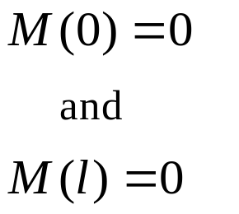
Example
1st order
Linear
Nonhomogeneous
Initial value problem
2nd order
Linear
Nonhomogeneous
Boundary value problem

Slide 16
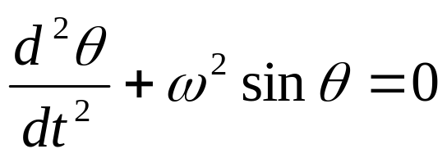
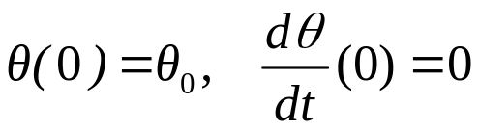
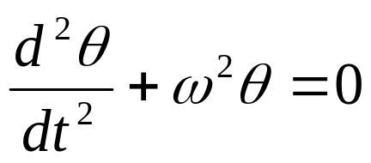
Example
2nd order
Nonlinear
Homogeneous
Initial value problem
2nd order
Linear
Homogeneous
Initial value problem

Slide 17
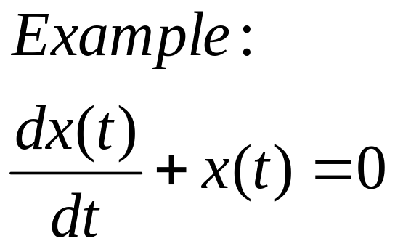
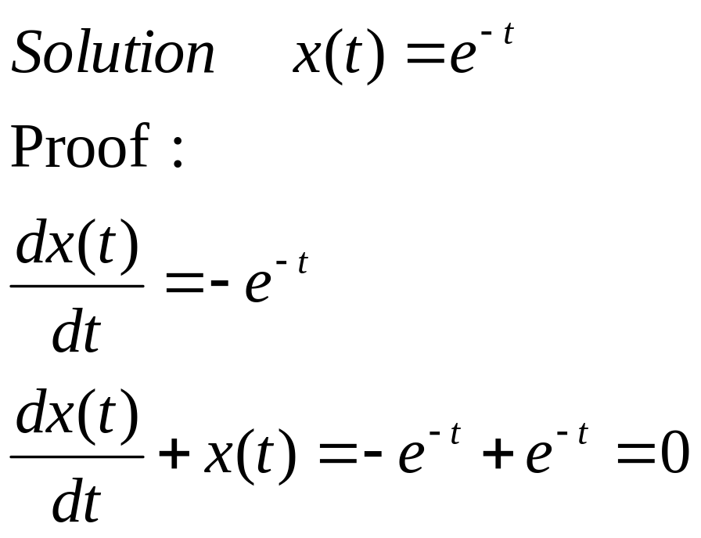
Solution of a Differential Equation
A solution to a differential equation is a function that satisfies the equation.

Slide 18
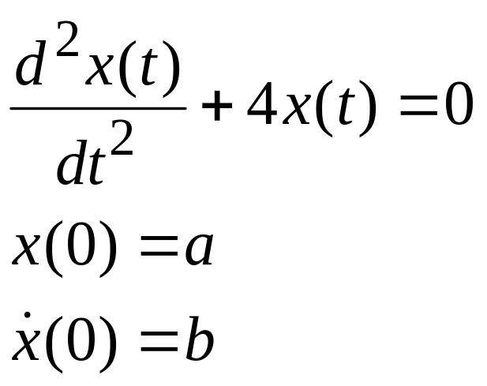
Uniqueness of a Solution
In order to uniquely specify a solution to an n^{th} order differential equation we need n conditions.
Second order ODE
Two conditions are needed to uniquely specify the solution

Slide 19
Auxiliary Conditions
Auxiliary Conditions
Initial Conditions
All conditions are at one point of the independent variable
Boundary Conditions
The conditions are not at one point of the independent variable

Slide 20
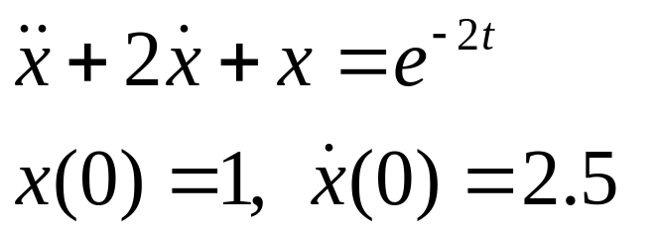
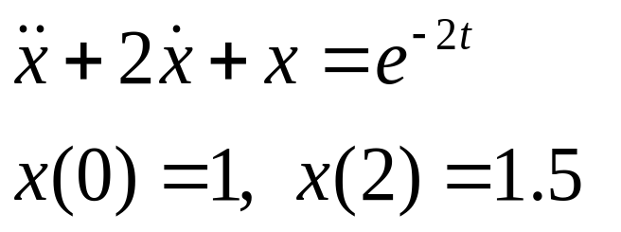
Boundary-Value and
Initial value Problems
Initial-Value Problems
The auxiliary conditions are at one point of the independent variable
Boundary-Value Problems
The auxiliary conditions are not at one point of the independent variable
More difficult to solve than initial value problems
same
different

